Slide 1
Data for AI
DAVE3625 · Lecture 2 · Week 36
Umair Mehmood Imam

Slide 2

$326 million
The Mars Climate Orbiter, 1999.
December 1998 – September 1999
Nine months of flight. It burned up on arrival.
Introduction to A.I · Umair M.I
2
Notes:
CONTEXT — Launched 11 December 1998, arrived 23 September 1999. It fired its engine to enter orbit, passed roughly 57 km above the surface instead of the planned 226 km, and was destroyed by atmospheric stress. Total mission cost is usually cited at about $327.6M — around $193M spacecraft, $92M launch, $43M operations.
LINK — Sources are in PREP.md section 4 in case a student challenges the number.

Slide 3
One team sent thrust in pound-force seconds. The other read it as newton-seconds (imperial versus metric).
Nobody's code was wrong. The units in the data were.
Introduction to A.I · Umair M.I
3
Notes:
CONTEXT — Lockheed Martin's ground software produced impulse figures in imperial units; NASA JPL's navigation software expected metric. Each program was internally correct and passed its own tests. A newton is about 0.225 pound-force, so the trajectory was off by a factor of roughly 4.45 — accumulating silently over nine months of small trajectory corrections. The NASA failure board's own summary named the units mismatch as the root cause.

Slide 4
15 841
COVID cases missing from England's contact tracing, October 2020.
Roughly 48 000 people (close contacts) were never told to isolate.
Introduction to A.I · Umair M.I
4
Notes:
CONTEXT — Public Health England, reported 4 October 2020. Cases from 25 September to 2 October were missing from the contact-tracing system. Roughly 48 000 close contacts of infected people were not reached in the window where isolation would have mattered. The consequence of a data-handling default was measured in transmission, not in money.
LINK — Same root cause family as the Excel gene story two slides from now.

Slide 5
The results were being passed around in the old Excel format. It stops at 65 536 rows.
Every row past the limit was silently dropped. No error, no warning.
Introduction to A.I · Umair M.I
5
Notes:
CONTEXT — Lab results were transferred as CSV, then loaded into the legacy .xls format, which has a hard limit of 65 536 rows and 256 columns. Each template held a fixed number of cases; once full, additional rows were simply not included. Nothing crashed. The modern .xlsx format allows 1 048 576 rows, so the fix was trivial — the failure was that nobody was checking row counts.

Slide 6
SEPT2 (a septin)
MARCH1 (a membrane-associated ring finger)
27 genes
SEPT2 → SEPTIN2
Human genes renamed by scientists in 2020…
…because Excel kept turning SEPT2 into 2-Sep and MARCH1 into 1-Mar.
MARCH1 → MARCHF1
And 27 more
Introduction to A.I · Umair M.I
6
Notes:
CONTEXT — The HUGO Gene Nomenclature Committee updated its guidelines in 2020 and renamed symbols that spreadsheets corrupt: SEPT2 became SEPTIN2, MARCH1 became MARCHF1. Excel's default type inference converted the symbols to dates on import, and published gene lists in supplementary files were measurably affected — studies have found date-corrupted gene names in a fifth of papers with Excel supplements. Rather than fight the tool, an entire field changed its vocabulary.
LINK — Slides 31–34: the messy Norwegian CSV, and read_csv written defensively.

Slide 7
None of these were algorithm failures.
Every one of them was a data failure. That is what today is about.
Introduction to A.I · Umair M.I
7
Notes:
CONTEXT — Three failures: a units mismatch, a silent row limit, and type inference corrupting identifiers. No model was involved in any of them. Every one was preventable by someone looking at the data and asking what the values meant. That is the skill this lecture teaches, and it is the skill Assignment 1 assesses.
Emneplan learning outcome: 'can evaluate the technical quality and practical value of various types of artificial intelligence.' It starts with the data.

Slide 8
How much of an AI practitioner's time goes on data?
▪ A About 20%
▪ B About 40%
▪ C About 60%
▪ D About 80%
Introduction to A.I · Umair M.I
8

Slide 9
80% approx
Data: collecting, cleaning, labelling, preparing, analysing.
15% model development. 5% deployment.
Introduction to A.I · Umair M.I
9

Slide 10
Data for AI
▪ Why data is the actual job
▪ A model with 99% accuracy — and why you should be worried
▪ Reading a dataset you have never seen before
▪ Missing values, duplicates, outliers, inconsistent categories
▪ Encoding, scaling, feature engineering
▪ Splitting data — and the one rule you must not break
▪ Labelling, privacy and synthetic data
▪ Your challenge at the end: break a model without lowering its accuracy
Introduction to A.I · Umair M.I
10

Slide 11
Data is the job
PART 1
Introduction to A.I · Umair M.I
11

Slide 12
In most real projects, the fastest way to improve a model is to improve the data — not the algorithm.
If you remember one sentence from this lecture, remember this one.
Introduction to A.I · Umair M.I
14
Notes:
CONTEXT — Concretely: fixing a mislabelled target, adding one well-chosen engineered feature, or collecting 500 more examples of a rare class will usually beat swapping logistic regression for a gradient-boosted ensemble. Andrew Ng makes the same argument at length in Machine Learning Yearning, which is on the reading list — error analysis before model complexity.
LINK — Machine Learning Yearning chapters 13–19 (error analysis)

Slide 13
From my own projects
▪ RuterGPT — a Norwegian language model for transport
– The training run was the short part. Getting usable Norwegian text was not.
▪ TeT Whisper — audio model for customer service calls
– 15 seconds between phone calls. That constraint shaped the whole dataset.
▪ Health AI — labelling regions of eye images for dry eye disease
– Clinicians had to agree on what counted as a region before anything could train.
▪ In each one, the model was weeks. The data was months.
Introduction to A.I · Umair M.I
16

Slide 14
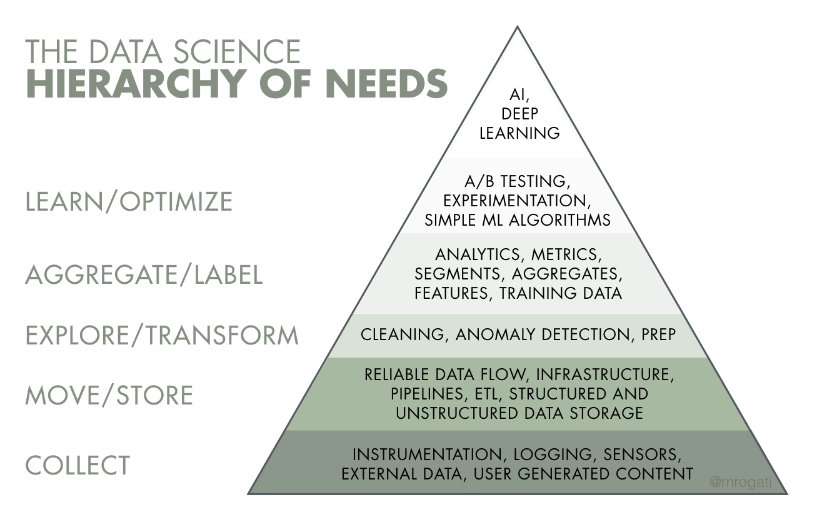
The AI hierarchy of needs
Layer | What it involves
6. AI / deep learning | The part everyone wants to talk about
5. Learn / optimise | Simple ML, A/B testing, experimentation
4. Aggregate / label | Analytics, metrics, labelled datasets ← today
3. Explore / transform | Cleaning, preparation, anomaly detection ← today
2. Move / store | Pipelines, ETL, databases
1. Collect | Instrumentation, logging, sensors
After Monica Rogati. Organisations that try to start at the top fail, expensively.
Introduction to A.I · Umair M.I
15
Notes:
CONTEXT — Rogati's analogy is Maslow's hierarchy: you cannot self-actualise while starving. An organisation with no reliable logging and no data warehouse cannot do deep learning, regardless of budget — which is why so many 'AI strategies' quietly become data platform projects in year one.

Slide 15
Steps to design an A.I system
▪ Identify the problem
▪ Prepare the data
▪ Choose the algorithms
▪ Train the algorithms with the data
▪ Run on a selected platform
Step 3 is what people talk about at conferences. Step 2 is what people do at work.
Introduction to A.I · Umair M.I
12
Notes:
CONTEXT — Same five steps as previous years, deliberately — this is the frame students will see again in every later lecture. Note the order: the problem comes before the data, and the data before the algorithm. Choosing a model before you have looked at your data is the most common way student projects go wrong.

Slide 16
A.I is about algorithms, tools and data
Algorithms and tools
Data
▪ scikit-learn, PyTorch, pandas
▪ Free to download
▪ Your competitors have exactly the same ones
▪ Published in papers within weeks
▪ AI coding tools
▪ Scarce, expensive, regulated
▪ Specific to one organisation
▪ Cannot be downloaded by a competitor
▪ This is the actual asset
Introduction to A.I · Umair M.I
13
Notes:
CONTEXT — The asymmetry is the point. Any student in this room can install the same libraries as any AI team in the country, tonight, for free. What they cannot install is Ruter's travel data, a hospital's patient records, or a bank's transaction history. This is also why data access, not model choice, is what negotiations in industry are actually about — and why GDPR is a strategic constraint rather than paperwork.

Slide 17
Where data comes from
Source | Examples | Watch out for
Open ML datasets | Kaggle, UCI, Hugging Face | Pre-cleaned — unrealistically easy
Public sector open data | data.norge.no, SSB, Entur/Ruter, MET | Semicolons, decimal commas, æøå
Private / organisational | Customers, logs, transactions, sensors | GDPR, approvals, poor quality
Scraped web data | Pages, forums, social media | Terms of service, copyright, bias
Synthetic data | Faker, simulators, generative models | Only patterns the generator knows
Human annotation | You pay people to create labels | Cost, label noise, guidelines
Introduction to A.I · Umair M.I · reference slide — also in the handout
17
Notes:
CONTEXT — A Kaggle dataset with 40 000 downloads has already been cleaned by someone else, so practising on it hides the exact skill we are teaching. Norwegian public data is the opposite — SSB and municipal exports arrive with semicolon separators, decimal commas, '..' for missing values and Latin-1 encoding, which is why the lab uses them. Also flag that 'private organisational data' is where they will actually work, and that its quality is typically far worse than anything they have seen in a course.

Slide 18
Four questions before you use any data
▪ Context: What question am I actually trying to answer?
– Data collected for another purpose often cannot answer yours, however large it is.
▪ Legal: Do I have a lawful basis?
– If it describes identifiable people it is personopplysninger, and GDPR applies.
▪ Private data: Do I need identifiable data at all?
– Pseudonymised or aggregated data is usually enough and removes most of the risk.
▪ Is this data representative of where the model will be used?
– Trained on Oslo customers last year, deployed in Tromsø this year — that is new data.
Introduction to A.I · Umair M.I
18
Notes:
CONTEXT —
Question 1 guards against the most common project failure: a large dataset that cannot answer the question because it was collected for a different one.
Question 2 is GDPR Article 6 in plain language.
Question 3 is data minimisation — a legal principle that also happens to reduce your own risk.
Question 4 is distribution shift, and it is the reason models degrade after deployment even when nothing in the code changed.

Slide 19
You have the Data....
Now You improve the AI model
PART 2
Introduction to A.I · Umair M.I
19

Slide 20
Your model is 99% accurate.
PART 2
Introduction to A.I · Umair M.I
19

Slide 21
The setup
▪ Task: predict which customers will cancel their subscription next month
Data: 40 000 customers, 18 columns, exported from the CRM
▪ Model: logistic regression, straight out of scikit-learn, default settings
▪ Test accuracy: 99.2%
Introduction to A.I · Umair M.I
20
Notes:
CONTEXT — Churn prediction is the canonical business ML problem and one your students will meet in interviews. Note the details that make it feel legitimate: a proper train/test split is implied, the model is boring and standard, and the number is not 100% — which is exactly what makes a leaking model convincing rather than obviously broken.

Slide 22
The columns you were given
customer_id tenure_months monthly_price
plan_type payment_method n_support_tickets
last_login_days avg_session_min city
signup_channel age_band has_family_plan
n_devices data_used_gb contract_end
cancellation_reason churned_next_month region
Anything here bother you?
Introduction to A.I · Umair M.I
21
Notes:
CONTEXT — The offending column is bottom-left, deliberately placed where the eye lands last after scanning the top row. Everything else in the list is a legitimate feature. `churned_next_month` is the target; `customer_id` is an identifier that should also be dropped, and a sharp student may spot that one first — accept it as a good answer and keep hunting.

Slide 23
Why should you be worried?
▪ Find the reason this model cannot possibly work in production
▪ Hint: think about *when* each column gets filled in
Introduction to A.I · Umair M.I
22

Slide 24
cancellation_reason only exists after a customer has cancelled.
The model did not learn to predict churn. It learned to read the answer.
Introduction to A.I · Umair M.I
23
Notes:
CONTEXT — For a customer who has not cancelled, the field is empty; for one who has, it is filled in. So the model's most powerful feature is effectively 'has this person already cancelled?'. In production the column is null for every customer you actually want to score, and accuracy collapses to near the base rate. Note what makes this dangerous rather than merely wrong: nothing in the code is broken, no exception is raised, and the validation score agrees with the test score.

Slide 25
If a feature would only be known after the thing you are predicting has happened, it is data leakage.
And: if your accuracy is startlingly high, look for leakage before you celebrate.
Introduction to A.I · Umair M.I
25
Notes:
CONTEXT — The first line is a test they can apply to every column mechanically, without domain expertise. The second is the professional instinct: in real tabular problems, suspiciously good results are far more often a bug than a breakthrough. Teaching students to distrust their own good news is one of the more useful things this course can do.

Slide 26
Problem: Data leakage -> many ways it can happen
▪ Data collection problem: Target leakage –
- A feature recorded after, or because of, the outcome. Today's example.
▪ Coding problem: Train/test contamination
– Fitting a scaler, imputer or encoder on all the data before splitting.
▪ Duplicate rows across the split
– The same row in train and test, so the model is scored on what it memorised.
Introduction to A.I · Umair M.I
24
Notes:
CONTEXT —
Type 1 is a data-collection problem and needs domain knowledge to spot.
Type 2 is a code-ordering problem: `StandardScaler().fit_transform(X)` before the split lets the test set's mean and variance influence training, which inflates the score by a small but real margin — and it looks like tidy code, which is why it survives review.
Type 3 is why we check duplicates before splitting rather than after.

Slide 27
Know your data before you touch it
PART 3
Introduction to A.I · Umair M.I
26

Slide 28
Spot the flaws
A real export from a Norwegian system. How many problems can you find?
navn;postnr;kommune;pris;dato;antall
Ole Hansen;0150;Oslo;1 234,50;31.01.2026;3
Kari Nordmann;0575;OSLO ;2 100,00;01.02.2026;..
Åse Berg;9010;Tromsø;;2026-02-01;5
Ole Hansen;0150;oslo;1 234,50;31.01.2026;3
Per Ås;1341;Bærum;950,00;15.02.2026;-1
Introduction to A.I · Umair M.I
31
Notes:
CONTEXT — There are at least nine defects and most rooms find four or five. The value is in the gap: they will find the obvious formatting issues and miss the duplicate row and the '..' sentinel, which are the two that actually corrupt results. Keep the board list visible while you reveal, so they can see which ones they missed.

Slide 29
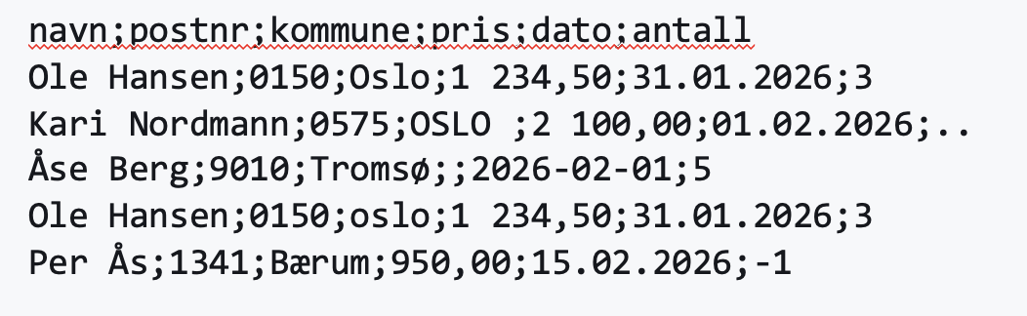
Eight defects, and every one of them is silent
▪ Semicolon separator — the default read_csv gives you one column
▪ Decimal comma and a space as thousands separator — pris loads as text
▪ Leading zeros — 0150 becomes 150 if read as a number
▪ Inconsistent categories — Oslo, OSLO , oslo are three categories
▪ Two date formats — 31.01.2026 and 2026-02-01 in one column
▪ `..` as missing — survives every null check and poisons the mean
▪ An empty value — pris missing on row 3
▪ A duplicate row — Ole Hansen appears twice
▪ An impossible value — antall of −1
▪ Plus one you cannot see on a slide: Åse and Tromsø need the right encoding.
Introduction to A.I · Umair M.I
32
Notes:
CONTEXT — Details if challenged: '..' is SSB's convention for 'not available'; the space in '1 234,50' is a Norwegian thousands separator, so pandas sees a string; the two date formats are unrecoverable if you cannot tell which convention a row used, and `to_datetime` will guess wrong on the ambiguous ones. −1 in `antall` is a numeric sentinel meaning 'unknown', which is worse than a blank because it survives `isnull()` and enters the mean.

Slide 30
Four silent failures and their fix
Symptom | Cause | Fix
One column holding the whole row | Wrong separator | sep=";"
A numeric column loaded as object | Decimal comma, spaces | decimal=","
Ã¦ Ã¸ Ã¥, or UnicodeDecodeError | Wrong text encoding | encoding="latin-1"
Postcodes lose their leading zero | Read as integers | dtype={"c": "string"}
Introduction to A.I · Umair M.I · reference slide — also in the handout
34
Notes:
CONTEXT — Worth keeping only as a diagnostic index: symptom on the left, so a student debugging in the lab can find their case. The mojibake row is the useful one — 'Ã¦ Ã¸ Ã¥' is UTF-8 bytes being read as Latin-1, and recognising the pattern saves an hour.

Slide 31
Anatomy of a dataset (Titanic data set as an example)
One row = one observation. One column = one variable. Shape = (rows, columns).
| Pclass | Sex | Age | Fare | Embarked | Survived |
--------+--------+--------+------+-------+----------+----------+
row 0 | 3 | male | 22.0 | 7.25 | S | 0 |
row 1 | 1 | female | 38.0 | 71.28 | C | 1 |
row 2 | 3 | female | 26.0 | 7.93 | S | 1 |
\------------- features (X) --------------/ \- target (y) -/
Introduction to A.I · Umair M.I
27
Notes:
CONTEXT — Titanic is the running example all term, so establish it now: 891 rows, 12 columns, target `Survived`. The X/y convention is not arbitrary — every scikit-learn call today takes X and y in that order, so the notation on this slide is the notation in the code. Note that 'label' specifically implies a human supplied the value, which is why Part 10 on annotation matters.

Slide 32
Feature types decide what you may do with a column
Type | Example | Encode? | Scale?
Numerical — continuous | Age, fare, temperature | No | Often
Numerical — count | Number of siblings, page views | No | Often
Categorical — nominal | Port, city, colour | Yes — one-hot | No
Categorical — ordinal | Low/Medium/High, ticket class | Yes — ordinal | Sometimes
Binary | Survived, is_spam | Map to 0/1 | No
Datetime | Timestamp of purchase | Derive features | —
Text | Review body, support ticket | Vectorise (Lecture 9) | —
Identifier | PassengerId, order number | Never a feature | —
Introduction to A.I · Umair M.I · reference slide — also in the handout
28
Notes:
CONTEXT — This table is the map for Parts 6 and 7: which treatment a column gets is decided by its type, not by taste. Nominal versus ordinal is the distinction that carries real consequences (slide 63). The identifier row matters because an ID contains no predictive information yet a flexible model will still find spurious structure in it — especially if IDs were assigned in a meaningful order, which they usually were.

Slide 33
Quick fire: numeric or category?
▪ Pclass — ticket class stored as 1, 2, 3
▪ postnummer — 0150, 0575, 9010
▪ shoe_size — 38, 41, 44
▪ phone_number — 90 12 34 56
▪ n_children — 0, 1, 2, 3
Introduction to A.I · Umair M.I
29
Notes:
CONTEXT — Answers:
Pclass is an ordinal category — its mean of 2.31 is not a class and cannot be interpreted.
postnummer is nominal and must be a string, or 0150 becomes 150.
shoe_size is genuinely ordered and roughly interval, so treating it as numeric is defensible.
phone_number is an identifier — never a feature.
n_children is a real count and the only unambiguously numeric one. The closing line is the teaching point: pandas will happily average all five, so the tool cannot protect you.

Slide 34
Tidy data — fix the shape first
▪ Untidy data you will actually meet:
– One column per month: sales_jan, sales_feb, … instead of a month column
– Two variables in one column: "Oslo, 0150"
– A single cell holding a comma-separated list
▪ One row per observation
▪ One column per variable
▪ One table per kind of observation
Introduction to A.I · Umair M.I · reference slide — also in the handout
30
Notes:
CONTEXT — Hadley Wickham's tidy-data formulation. It matters here because every pandas and scikit-learn operation today assumes one row per observation — group-by, train/test split and fit all break in confusing ways on wide or nested data. The month-columns shape is what students get from Excel exports; the answer is `melt` to long format before anything else.
LINK — Handout section 3. Reference slide.

Slide 35
Loading a file defensively
The read_csv call you should be writing for Norwegian data
df = pd.read_csv(
"sales.csv",
sep=";", # European CSVs are usually semicolon-separated
decimal=",", # "1 234,50" is one number, not text
thousands=" ",
encoding="utf-8", # try "latin-1" if you see Ã¦ Ã¸ Ã¥
na_values=["", " ", "-", "..", ":", "ukjent", "unknown"],
dtype={"postnr": "string"}, # keep the leading zero
)
Introduction to A.I · Umair M.I
33
Notes:
CONTEXT — `na_values` at load time is the cheapest fix in the lecture: it converts the disguised missing values before they can hide from `isnull()`. `dtype={'postnr': 'string'}` is the fix for the gene/postcode class of bug — you override type inference instead of trusting it. If they hit an unknown separator, `sep=None, engine='python'` will sniff it. Mention that the same arguments exist for `read_excel` apart from `sep`.

Slide 36
Fix the dtypes immediately after loading
df["price"] = pd.to_numeric(df["price"], errors="coerce") # bad -> NaN, no crash
df["date"] = pd.to_datetime(df["date"], format="%d.%m.%Y", errors="coerce")
df["city"] = df["city"].astype("category")
df["price"].isnull().sum() # how much did coercion silently throw away?
Introduction to A.I · Umair M.I
35
Notes:
CONTEXT — `errors='coerce'` converts what it can and turns the rest into NaN, so unparseable junk becomes a *visible* missing value instead of an exception or a column stuck as text. That is the right trade — but it silently discards data, so you must count what you created, which is why the last line exists. `astype('category')` cuts memory substantially on repeated strings and documents your intent that the column is not numeric.

Slide 37
First contact with a dataset
PART 4
Introduction to A.I · Umair M.I
36

Slide 38
Five commands, always in this order
df.shape # (891, 12) -> (rows, columns). NOT the element count.
df.head() # do the values match what the column names promise?
df.info() # dtype + non-null count per column — the most useful one
df.describe() # count/mean/std/min/quartiles/max — numerical columns
df.describe(include="object") # count/unique/top/freq — text columns
Introduction to A.I · Umair M.I
37
Notes:
CONTEXT — The order is deliberate: size, then a look at real values, then structure and missingness, then distributions. `shape` returns a tuple `(rows, columns)` — `df.size` is the element count, and the exam uses that as a distractor. `describe()` silently covers numerical columns only, which is why the fifth line exists; students routinely conclude a dataset has no categorical columns because `describe()` did not mention them.

Slide 39
Reading df.info() — three things at once
▪ Non-null count below the row count → missing values in that column
▪ `object` dtype on something that should be numeric → there is dirt in it
▪ A column you did not expect → a stray index, or an ID that must never be a feature
If you only ever run one command on a new dataset, run this one.
Introduction to A.I · Umair M.I · reference slide — also in the handout
38
Notes:
CONTEXT — This is the diagnostic skill, not a command list. Point 2 is the highest-value signal: an `object` dtype on a column whose name promises a number means text is hiding in there — a stray 'N/A', a decimal comma, a 'ukjent'. Point 3 catches the `Unnamed: 0` column that appears whenever someone saved a CSV with `index=True`.

Slide 40
Then look at columns one at a time
df["Embarked"].value_counts(dropna=False) # dropna=False so you SEE the NaNs
df["Survived"].value_counts(normalize=True) # class balance — always check
df["Age"].hist(bins=30) # shape of the distribution
df.boxplot(column="Fare") # the standard outlier view
df.corr(numeric_only=True) # linear relationships
df.nunique() # 1 = useless, n = identifier
Introduction to A.I · Umair M.I
39
Notes:
CONTEXT — `value_counts()` hides NaNs by default, which means the default hides exactly what you are looking for — a small habit with a large payoff. On `corr()`: it measures *linear* association between numerical columns only, and it has two genuine uses at this stage — a feature suspiciously correlated with the target suggests leakage, and two features correlated around 0.95 mean one is redundant. Say the obligatory line: correlation is not causation. Ice-cream sales correlate with drownings; summer causes both.

Slide 41
EVERYONE VOTES · NO RUNNING IT
Predict the output
data = {
"A": [1, 8, np.nan, None],
"B": [5, None, 7, 8],
"C": ["X", "", "None", " "],
}
df = pd.DataFrame(data)
df.isnull().sum()
Introduction to A.I · Umair M.I
41
Notes:
CONTEXT — This is the best reveal in the lecture because the answer feels wrong. Column A has `np.nan` and `None`, both null → 2. Column B has one `None` → 1. Column C has an empty string, the four-character string 'None', and a single space — all valid strings, so 0. The pedagogical value is that it separates 'looks missing to a human' from 'is missing to pandas'.

Slide 42
VOTE
Which is it?
▪ A A→2 B→1 C→0
▪ B A→2 B→1 C→3
▪ C A→1 B→1 C→1
▪ D A→2 B→1 C→1
Introduction to A.I · Umair M.I
42
Notes:
CONTEXT — The answer is A. B is the intuitive wrong answer — 'three of those look empty'. D catches those who count only the empty string. Writing the counts on the board makes the correction public and memorable, and it tells you how the cohort thinks.

Slide 43
The answer: C reports zero missing values
"" is an empty string. "None" is four characters. " " is a space. All valid strings.
A 2
B 1
C 0 # <-- zero
Only np.nan and None count as null to pandas.
Everything else that LOOKS missing is not.
Introduction to A.I · Umair M.I
43
Notes:
CONTEXT — Only `np.nan`, `None` and `pd.NA` register as null. Everything else — empty strings, whitespace, 'None', 'N/A', '-', '..', and numeric sentinels like -1 or 999 — passes every null check. This is the same failure mode as the '..' in the Norwegian CSV two sections ago, which is why that exercise came first.

Slide 44
So strip the disguises first
df = df.replace(["", " ", "-", "..", "None", "N/A", "unknown"], np.nan)
df["C"] = df["C"].str.strip().replace("", np.nan)
# and watch for NUMERIC sentinels, which are worse:
# -1 for an unknown count, 999 for an unrecorded age,
# 0 for a missing blood-pressure reading
Introduction to A.I · Umair M.I
44
Notes:
CONTEXT — Order matters: strip whitespace, then replace the empty string, or ' ' survives. Numeric sentinels are worse than string ones because they are the right dtype, so they pass every check and go straight into the mean — an unrecorded age of 999 in a hundred rows will visibly move a distribution, and a 0 blood pressure will not even look odd in `describe()` unless you know that 0 is impossible. This is where domain knowledge stops being optional.

Slide 45
What “clean data” actually means
PART 5
Introduction to A.I · Umair M.I
45

Slide 46
Who is missing from these rows?
▪ Facial recognition trained mostly on light-skinned faces → worse on dark-skinned faces
▪ A recruitment model trained on past hires → learns the company's past preferences
– Including preferences it is illegal to act on, reconstructed from proxy variables
▪ A speech model trained on Oslo speakers → struggles with Bergen dialects
▪ A health model that works in one hospital → fails in another
Introduction to A.I · Umair M.I
48
Notes:
CONTEXT — Concrete backing: Buolamwini and Gebru's Gender Shades (2018) measured error rates up to 34% for darker-skinned women against under 1% for lighter-skinned men in commercial gender-classification systems; NIST's 2019 FRVT study found demographic differentials across most algorithms tested. Reuters reported in 2018 that Amazon scrapped an internal CV-screening tool that penalised CVs containing 'women's' — trained on a decade of mostly male hires. The proxy-variable point is the subtle one: removing a protected attribute does not remove it from the data, because postcode, sports club and school reconstruct it.

Slide 47
Data pitfalls — the classics
▪ Assuming the data is clean — spelling mistakes, stray text, wrong units
▪ Outliers — excluding them, or including them, without deciding which
▪ Ignoring seasonality — Easter, summer holidays, Black Friday
– A 'collapse in sales' that is just July
▪ Losing the context — ignoring size when reporting growth
– 'Sales grew 300%!' … from one unit to four
▪ Poor data insights, not connecting to external data, no business understanding
Introduction to A.I · Umair M.I
47
Notes:
CONTEXT — Carried over from previous years because the list is still right. Seasonality is the one with a Norwegian edge: fellesferie in July, Easter moving between March and April, and the påskeferie effect on transport data — a model that has not been told about the calendar will read all of these as trend. The denominator point generalises: a percentage without its base is not information.

Slide 48
Annonymous customer profiling
Postcode
Travel pattern
gender
Food interest
date of birth
Social media feeds
Introduction to A.I · Umair M.I
49
Notes:
A simple exercise in the class

Slide 49
Postcode + date of birth + gender identifies most individuals uniquely.
Removing names is not anonymisation.
Introduction to A.I · Umair M.I
50
Notes:
CONTEXT — Latanya Sweeney's work in the 1990s showed that combinations of a handful of demographic fields identify the large majority of a population — the classic result used ZIP code, birth date and sex to re-identify individuals in 'anonymous' health records, including the governor of Massachusetts. The fields are called quasi-identifiers. The practical consequence for their assignments: dropping the name column is not anonymisation, and calling it that in a report is wrong.

Slide 50
The working checklist
▪ Missing values · disguised missing values · duplicate rows
▪ Wrong data type · inconsistent categories · spelling mistakes
▪ Outliers · impossible values · mixed units and formats
▪ Constant columns · identifier columns
▪ Ignored seasonality · wrong denominator · unrepresentative data
▪ Data leakage · stale data · mislabelled targets
▪ The first eleven have a pandas command. The last five need you to understand
▪ where the data came from.
Introduction to A.I · Umair M.I · reference slide — also in the handout
51
Notes:
CONTEXT — This is the artefact Assignment 1 expects them to work through in writing, which is why it exists as a slide at all — students need to see that 'check the data quality' is a finite, enumerable task rather than a vague instruction. The split in the last two lines is the important part: eleven items are mechanical, five require judgement, and the five that require judgement are where the expensive mistakes live.

Slide 51
Six dimensions of data quality
Accuracy is the one you cannot check from inside the file. That is why domain knowledge is irreplaceable.
Dimension | Question | Example failure
Completeness | Are values present? | 77% of Cabin is missing
Validity | Do values obey the field's rules? | Age 180, month 13, negative price
Accuracy | Do values match reality? | Valid address, but they moved
Consistency | Do values agree with each other? | Oslo vs OSLO; total ≠ sum of parts
Uniqueness | Is each real thing recorded once? | The same order imported twice
Timeliness | Is it current enough to be useful? | Prices from 2019
Introduction to A.I · Umair M.I · reference slide — also in the handout
46
Notes:
CONTEXT — This is standard data-management vocabulary, and it gives students something concrete to write in the quality report Assignment 1 asks for. The distinction worth teaching is validity versus accuracy: validity is checkable against rules inside the file (a month cannot be 13), while accuracy requires an external source of truth — a well-formed address for someone who moved last year is perfectly valid and wrong. No pandas command will ever tell you that.

Slide 52
Cleaning DATa: missing, duplicate, extreme, inconsistent
PART 6
Introduction to A.I · Umair M.I
52

Slide 53
Missing values: find them
df.isnull().sum() # count per column
df.isnull().mean().round(3) # proportion per column — usually more useful
df.isnull().sum(axis=1).value_counts() # rows with 1, 2, 3... missing fields
Introduction to A.I · Umair M.I
53
Notes:
CONTEXT — 0.2% missing and 77% missing are different problems even though both are 'missing' — the first is a row-drop, the second is a column-drop. The third line is less familiar and worth showing: it tells you whether missingness is spread thinly across many rows or concentrated in a few useless ones. If 40 rows are missing eight fields each, dropping those 40 rows is a cheap and honest fix.

Slide 54
Then decide — there is no universally right answer
Strategy | Use when | Cost
Drop rows | Few rows (<5%), data is plentiful | Biases the sample if not random
Drop the column | Most of it is missing (Cabin ≈ 77%) | Lose a possible signal
Mean | Roughly symmetric numbers | Shrinks variance; outlier-sensitive
Median | Skewed data (income, price) | Safer default
Mode | Categorical columns | Over-represents the commonest
Explicit category | 'Missing' is itself meaningful | Adds a category
Group-wise median | A related column predicts it | Nearly free, usually better
Missingness flag | Alongside any imputation | One extra column
Introduction to A.I · Umair M.I · reference slide — also in the handout
54
Notes:
CONTEXT — The examinable reasoning is why median beats mean on skewed data — one billionaire drags a mean income, while the median barely moves. The group-wise version is the upgrade worth showing in code: `df['Age'].fillna(df.groupby('Pclass')['Age'].transform('median'))` fills each passenger's age with the median for their own class, which is one line and clearly better than one global number. Every imputation choice must be defensible in the report — marking rewards the reason, not the choice.

Slide 55
Always ask WHY it is missing
High earners decline to state income. The sickest patients never finished the survey.
df.groupby(df["Age"].isnull())["Survived"].mean()
# If those two numbers differ, the missingness is NOT random —
# and imputing the mean fabricates a pattern that was never there.
df["Age_missing"] = df["Age"].isnull().astype(int) # keep the signal
Introduction to A.I · Umair M.I
55
Notes:
CONTEXT — The formal vocabulary is MCAR (missing completely at random), MAR and MNAR — you do not need the acronyms, but the distinction matters. If a sensor dropped a reading, imputation is harmless. If people with high incomes decline to state income, then 'missing' *is* the signal, and replacing it with the mean destroys information and invents a false one. On Titanic, `Age` is missing more often in third class and `Cabin` almost only for third class — so both missingness patterns carry class information. The one-liner tests this empirically in a second.

Slide 56
Duplicates
"Ole@x.no" and "ole@x.no " are not duplicates until you have normalised them.
df.duplicated().sum() # fully identical rows
df[df.duplicated(keep=False)].sort_values("Name") # LOOK before deleting
df = df.drop_duplicates()
# partial duplicates: normalise FIRST, then deduplicate
df["email"] = df["email"].str.strip().str.lower()
df = df.sort_values("updated_at").drop_duplicates(subset=["email"], keep="last")
Introduction to A.I · Umair M.I
56
Notes:
CONTEXT — Order matters — deduplicating before normalising misses every near-duplicate, which is most of them in real data. `keep='last'` after sorting by an update timestamp is the standard 'keep the newest record' idiom. And the warning: two identical rows in a transaction log may be two real purchases of the same item at the same price, so `drop_duplicates()` on a fact table can destroy data. Decide which columns define identity before you touch it.

Slide 57
Outliers: the IQR rule is what a box plot draws
Outliers: In statistics, an outlier is a data point that differs significantly from other observations.
Excluding outliers: Those 21 people using your product more than a thousand times a day? Either they’re your biggest fans, or bots crawling your site for content. Whichever they are, ignoring them would be a mistake.
Introduction to A.I · Umair M.I
57
Notes:
Including Outliers: While those 21 people using your product a thousand times a day are interesting from a qualitative perspective, because they can show you things you didn’t expect, they can be problematic when building models. You probably want to exclude them when building data products; otherwise, the ‘…you may also like…” feature on your site will have the same items everywhere.
----

Slide 58
Then decide what the outlier means
It is an error
It is real
▪ Negative age, price of 0, duplicate sensor spike
▪ Remove it — a validity failure
▪ Or cap it to the IQR bound to keep the row
▪ The fraudulent transaction. The failing machine.
▪ Keep it — in fraud and predictive maintenance the outliers ARE the target
▪ If the whole column is skewed, transform it: np.log1p
Both blanket policies are wrong. Deleting every outlier makes your model good at data that does not exist.
Introduction to A.I · Umair M.I
58
Notes:
CONTEXT — The decision rule is whether the value is an error or an observation, and that is a domain question, not a statistical one. Capping is called winsorising and is the middle path: you keep the row and its other columns while limiting one value's leverage. `np.log1p` (log of 1+x) handles skew and tolerates zeros, and it is the right move for prices, incomes and populations — which are skewed by nature rather than by error. In fraud detection and predictive maintenance, deleting outliers deletes the entire positive class.

Slide 59

Inconsistent categories
df["City"].nunique() # 340 — but Norway has fewer relevant cities than that
df["City"] = (df["City"]
.str.strip() # trailing whitespace
.str.replace(r"\s+", " ", regex=True) # internal whitespace
.str.lower()) # case-fold
df["City"] = df["City"].replace({"olso": "oslo"}).str.title()
Introduction to A.I · Umair M.I
59
Notes:
CONTEXT — This is not cosmetic — it fragments the data. 'Oslo', 'oslo' and 'OSLO ' become three separate categories, so a model sees three weak signals instead of one strong one, and one-hot encoding produces three nearly-empty columns. Fixed order: strip, collapse internal whitespace, case-fold, then map known misspellings, then re-case for presentation. For genuinely messy free text, fuzzy matching (`rapidfuzz`) can propose groupings — but review them by hand, because automatic merging eventually merges two things that were different.

Slide 60
Merging datasets: three ways it goes wrong
▪ Rows vanish — how="inner" is the default, and half your keys did not match
– Usually because one key is "0150" (string) and the other is 150 (int)
▪ Rows multiply — the right table had duplicate keys; 10 000 orders become 34 000
– validate="many_to_one" raises immediately instead of corrupting quietly
▪ Silent nulls — a left join fills unmatched columns with NaN…
– …which you then dutifully impute, inventing data for records that never existed
Introduction to A.I · Umair M.I · reference slide — also in the handout
60
Notes:
CONTEXT — Assignment 1 uses a single file, so this is preparation for Assignment 2 and for real work. The three failures share one detection method: compare row counts. `validate='many_to_one'` and `indicator=True` are the two arguments worth knowing — the first raises on unexpected duplicate keys, the second adds a `_merge` column showing both / left_only / right_only, which tells you immediately how much did not match. Note the string-vs-int key mismatch is the postcode problem again.

Slide 61
Making data which AN ai model can use
PART 7
Introduction to A.I · Umair M.I
61

Slide 62
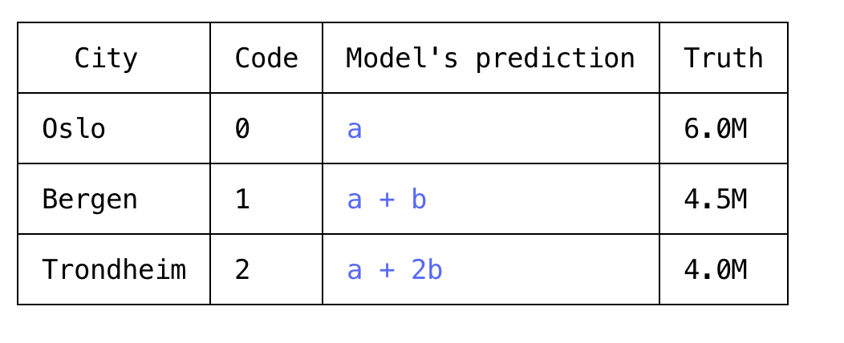
One-hot encoding — for nominal categories
Encoding Oslo=0, Bergen=1, Trondheim=2 tells the model that Bergen is halfway between Oslo and Trondheim.
A linear model takes that literally. Use one-hot for nominal categories.
Introduction to A.I · Umair M.I
63
Notes:
CONTEXT — This is the mistake most groups make in Assignment 1, usually via `LabelEncoder`, whose name invites it — it is intended for the *target* column, not for features. Ordinal encoding is correct when the order is real (Low < Medium < High, or ticket class), and then you should define the mapping yourself rather than let alphabetical order decide. Tree-based models are less damaged by arbitrary integer codes because they split on thresholds rather than compute distances, but do not rely on it.

Slide 63
Age: 0–80. Salary: 300 000–1 200 000.
Compute the distance between two people and age effectively stops existing.
Introduction to A.I · Umair M.I
64
Notes:
CONTEXT — Euclidean distance between two people differing by 10 years and 150 000 kroner: the age term contributes 100, the salary term 22 500 000 000. Age is not merely outweighed, it is numerically irrelevant. That is the whole motivation for scaling, and deriving it beats asserting it — students who see the arithmetic once never ask again why KNN needs scaling.
Distance-based algorithms measure how similar two rows are by summing squared differences, one feature at a time:
d² = (age_A − age_B)² + (salary_A − salary_B)²
Two people: A is 30 earning 450 000, B is 40 earning 600 000.
d² = (40 − 30)² + (600 000 − 450 000)²
= 100 + 22 500 000 000
Age contributes 100 out of 22.5 billion — about four ten-millionths of the distance. The algorithm believes it's using both features. Arithmetically it is using salary and nothing else.
The version worth saying out loud:
Push it to the limit. The largest age gap possible in the data is 80 years:
80² = 6 400
A salary difference of just 80 kroner gives the same 6 400. So in an unscaled distance, a 100-kroner difference in pay outweighs the entire human lifespan. That line lands harder than any definition of standardisation, and it takes fifteen seconds.
…..

Slide 64
Which algorithms need scaling?
Needs it | Why | Does not need it
KNN | Literally distance-based | Decision trees
SVM | Margins depend on distances | Random forests
K-means | Distance to centroids | Gradient-boosted trees
Neural networks | Gradient descent converges badly | Naive Bayes (mostly)
PCA, Ridge, Lasso | Variance and penalties are scale-sensitive | Plain linear regression*
* Its predictions are unaffected — but its coefficient sizes are, so never read unscaled coefficients as importances.
Introduction to A.I · Umair M.I · reference slide — also in the handout
65
Notes:
CONTEXT — The exam-ready formulation is that scaling 'ensures all features contribute equally to the model'. Note the distractor: 'it improves the accuracy of every ML model' is false, and the right-hand column is why — a decision tree asks 'is Fare > 30?', and that threshold works identically on any linear rescaling. Standardisation (mean 0, sd 1) is the usual default; min-max squeezes into [0, 1] but one extreme value compresses everything else; RobustScaler uses median and IQR when outliers remain.

Slide 65
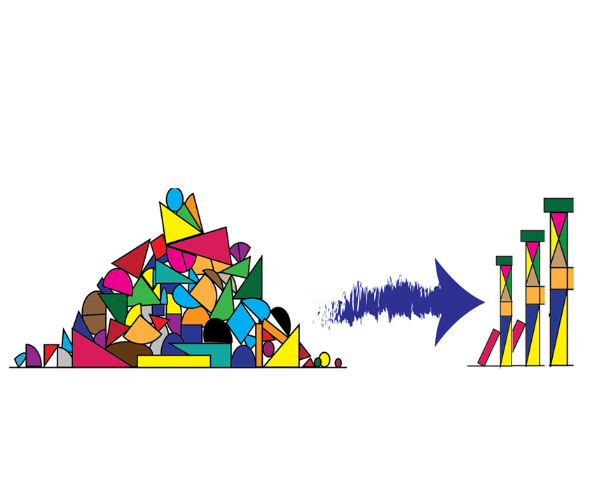
Feature engineering: this is where you beat a fancier model
Title extracts class, sex and rough age from a text field that looked useless.
df["FamilySize"] = df["SibSp"] + df["Parch"] + 1
df["IsAlone"] = (df["FamilySize"] == 1).astype(int)
df["FarePerPerson"] = df["Fare"] / df["FamilySize"]
df["Title"] = df["Name"].str.extract(r",\s*([^\.]+)\.") # Mr, Mrs, Miss, Master
df["HasCabin"] = df["Cabin"].notna().astype(int) # from a 77%-missing column
Feature engineering, also known as feature creation, is the process of constructing new features from existing data to train a machine learning model.
Introduction to A.I · Umair M.I
67
Notes:
CONTEXT — `Title` is the showpiece — `Name` looks like a useless identifier, but the honorific encodes sex, marital status, rough age and social class simultaneously, and 'Master' specifically marks boys, which is strongly predictive of survival. `HasCabin` rescues a column they were about to delete: whether a cabin was recorded is itself class information. `FarePerPerson` matters because the fare in this dataset is per ticket, not per passenger, so a family's fare looks like wealth until you divide. No algorithm would have found any of these — a person who thought about the Titanic did.

Slide 66
For example
Character recognition
  features may include histograms counting the number of black pixels along horizontal and vertical directions, number of internal holes, stroke detection and many others.
Speech recognition
  features for recognizing phonemes can include noise ratios, length of sounds, relative power, filter matches and many others.
Spam detection
  features may include the presence or absence of certain email headers, the email structure, the language, the frequency of specific terms, the grammatical correctness of the text.
Computer vision
  there are a large number of possible features, such as edges and objects.

Slide 67
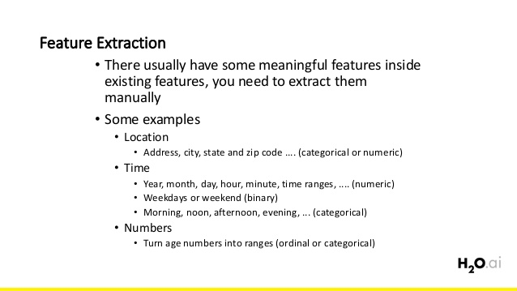

Slide 68

Notes:
Extract features from this image

Slide 69
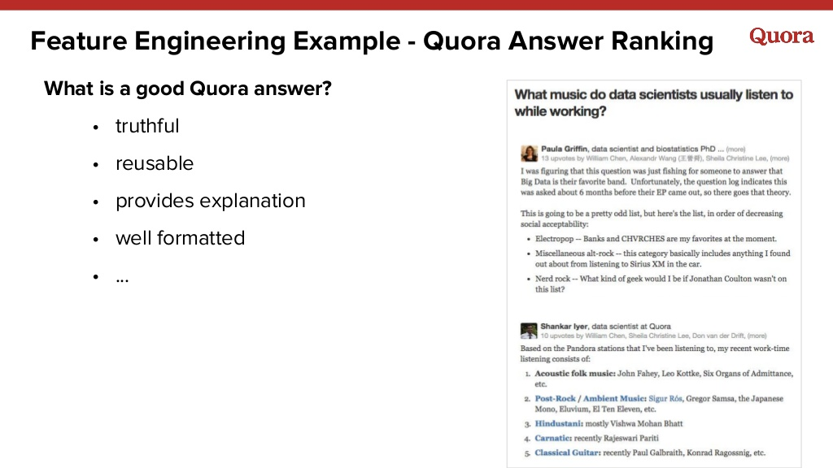
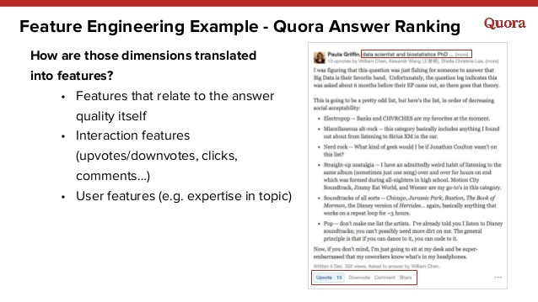

Slide 70
Ratios, dates and groups
# models struggle to learn a / b from a and b — so give them the ratio
df["price_per_m2"] = df["price"] / df["area"]
df["hour"] = df["ts"].dt.hour # a raw timestamp is nearly useless
df["is_weekend"] = df["ts"].dt.dayofweek.isin([5, 6]).astype(int)
# aggregate when the data is finer-grained than the prediction
df["mean_fare_for_class"] = df.groupby("Pclass")["Fare"].transform("mean")
Introduction to A.I · Umair M.I
68
Notes:
CONTEXT — Ratios: a linear model cannot represent division, so `a/b` must be handed to it explicitly — price per square metre, sales per employee, clicks per impression. Datetime: a raw timestamp is a near-unique number and therefore useless, while `hour` and `is_weekend` are strongly predictive for transport, retail and energy data — this is also how you stop seasonality masquerading as trend. Aggregation: `transform` returns one value per original row (unlike `agg`, which returns one per group), which is what you need when creating a feature. To predict churn from a transaction log you aggregate to one row per customer: total spend, order count, days since last order.

Slide 71
More features is not better
▪ Irrelevant features add noise, raise overfitting risk and hide the explanation
▪ Curse of dimensionality: as features grow, the space grows exponentially, your data becomes sparse in it, and distances between points become almost uniform
– Which is precisely what breaks KNN, K-means and SVM
▪ Free wins: drop identifiers, drop constant columns, drop one of every near-duplicate pair
▪ Then: correlation pruning → SelectKBest → tree importances / Lasso → RFE
▪ Any selection that looks at the target must be fitted on train only.
Introduction to A.I · Umair M.I
69
Notes:
CONTEXT — Intuition: with one feature, ten evenly spread points cover the line reasonably. With ten features, you would need 10^10 points for the same coverage — so real data is always sparse in high dimensions, and every point becomes roughly equidistant from every other. That is fatal for methods built on distance. Selection order in practice: drop the obviously useless, prune correlated pairs, then let a model tell you (tree importances, or Lasso's L1 penalty driving coefficients to exactly zero). Selecting features using the whole dataset is a very common way for a student report to overstate its results.

Slide 72
DATA Splitting, and why it happens before everything
PART 8
Introduction to A.I · Umair M.I
70

Slide 73
train_test_split
X_train, X_test, y_train, y_test
X = df.drop(columns=["Survived"]) # features
y = df["Survived"] # target
X_train, X_test, y_train, y_test = train_test_split(
X, y,
test_size=0.2, # 80% train, 20% test
random_state=42, # same split every run
stratify=y # preserve the class balance in both halves
)
Introduction to A.I · Umair M.I
71
Notes:
CONTEXT — The four returned objects always come in that order — X_train, X_test, y_train, y_test — and getting it wrong produces confusing errors, so it is worth stating. `test_size=0.2` means 80/20 train/test;
This is also the moment to restate why we hold data back at all: a model's score on data it fitted is a measure of memory, not of learning.

Slide 74
Three arguments, three reasons
▪ `test_size=0.2` → 80% train / 20% test. Not the other way round.
▪ `random_state=42` → your group gets the same split and the same numbers
– Without it, your 'improvement' may just be a luckier shuffle
▪ `stratify=y` → keeps the class balance identical in both halves
– With 10% positives and no stratification, the test set can end up with almost none
Introduction to A.I · Umair M.I · reference slide — also in the handout
72
Notes:
CONTEXT — `random_state` is reproducibility, not superstition: without it, two runs give different scores and you cannot tell whether your change helped or the shuffle did. Their report must reproduce when I run it. `stratify=y` matters whenever classes are imbalanced, and it costs nothing when they are not — so it may as well be a habit.

Slide 75
Three sets, not two
Set | Purpose | Seen by the model?
Training | Fit the model's parameters | Yes, directly
Validation | Choose hyperparameters, compare models | Indirectly — through your choices
Test | One final honest estimate | No — ideally used once
Every time you look at the test score and change something, you leak information through your own decisions.
Introduction to A.I · Umair M.I
73
Notes:
CONTEXT — The third column is the useful distinction: the model never fits the validation set, but *you* do — every choice you make after looking at a score transfers information from that data into the model. That is why the test set is held back for one final look, and why leaderboard scores drift optimistic over a competition. A reasonable default for a few thousand rows is 60/20/20; with very large datasets, validation and test can be a much smaller fraction, because what matters is their absolute size, not the percentage.

Slide 76
When random splitting is wrong
▪ Time series — predicting the past from the future is leakage
– Split by time: train on Jan–Sep, test on Oct–Dec. TimeSeriesSplit.
▪ Grouped data — ten photos of the same patient, twenty reviews by the same user
– The model learns to recognise the patient, not the disease. GroupShuffleSplit.
▪ Already-oversampled data — copies of the same row land on both sides
– Resample the training set only, and only after splitting
Introduction to A.I · Umair M.I
74
Notes:
CONTEXT — Time series: a random split trains on October and tests on September, which is not a task anyone will ever ask the model to do; the honest evaluation trains on the past and tests on the future. Grouped data: with ten images per patient split randomly, the same patient appears on both sides, so the model can score well by recognising the individual — a real and repeatedly published failure in medical imaging. Both are the same underlying error: the split must mirror how the model will actually be used.

Slide 77
99% accuracy again — this time honestly
▪ 99% of transactions are legitimate
▪ 'Always predict legitimate' → 99% accuracy, zero fraud caught
▪ What to change:
– The metric — precision, recall, F1, confusion matrix (Lecture 6)
– `class_weight="balanced"` — errors on the rare class cost more. Try this first.
– Undersample the majority, or oversample the minority (SMOTE)
– Collect more of the rare class — always the best answer
Introduction to A.I · Umair M.I
75
Notes:
CONTEXT — This is class imbalance, and it belongs today because it is a property of the data, not of the model. The ordering on the slide is the recommended order of attack: fix the metric first (often sufficient on its own), then try `class_weight='balanced'`, which is one argument and costs nothing, and only then resample. SMOTE interpolates between existing minority points rather than duplicating them, and lives in `imbalanced-learn`. The rule that gets broken: resample the training set only, after the split, or copies of the same row land in both halves and recall becomes fiction.

Slide 78
Putting it together
PART 9
Introduction to A.I · Umair M.I
76

Slide 79
One object that does all of it
numeric = ["Age", "Fare", "SibSp", "Parch"]
categorical = ["Sex", "Embarked", "Pclass"]
preprocessor = ColumnTransformer([
("num", Pipeline([("imp", SimpleImputer(strategy="median")),
("sc", StandardScaler())]), numeric),
("cat", Pipeline([("imp", SimpleImputer(strategy="most_frequent")),
("oh", OneHotEncoder(handle_unknown="ignore"))]), categorical),
])
X_train_prep = preprocessor.fit_transform(X_train) # fit on TRAIN
X_test_prep = preprocessor.transform(X_test) # transform TEST
Introduction to A.I · Umair M.I
77
Notes:
CONTEXT — `ColumnTransformer` applies different treatments to different column groups, which is necessary because a median makes no sense for a category and one-hot makes none for an age. Optional for Assignment 1, expected by Assignment 2. Read it as a table: each tuple is (name, what to do, which columns). The two final lines are the rule from slide 66, now enforced by structure rather than discipline.

Slide 80
Why a pipeline is not over-engineering
▪ Leakage becomes hard to commit — there is one fit, and it only sees X_train
▪ Cross-validation becomes correct automatically — each fold re-fits its own preprocessing
▪ Deployment becomes possible — one object holds every transformation
– Hand-written prep code never survives contact with production
Introduction to A.I · Umair M.I
78
Notes:
CONTEXT — In cross-validation, each fold must have its imputer and scaler fitted on that fold's training portion only. Doing that by hand is tedious and everyone gets it wrong; attach the preprocessor to a model inside a `Pipeline` and scikit-learn does it correctly for free. Reason 3 is the industry argument: at prediction time new data must pass through exactly the same transformations, and a pipeline object is that guarantee, serialisable and testable.

Slide 81
Clean → engineer → SPLIT → then impute, encode and scale.
Anything that learns from the data — a mean, a category list, a scale — is fitted after the split.
Introduction to A.I · Umair M.I
79
Notes:
CONTEXT — The dividing line is whether an operation *learns a parameter from the data*. Dropping a column, renaming a category, extracting a title from a name and computing a ratio use no learned quantity, so they can happen before the split and it is more convenient there. Imputation learns a median, scaling learns a mean and standard deviation, encoding learns a category list, selection learns which features matter — all four must come after. If a student can articulate that test, they understand leakage and will not need to memorise the order.

Slide 82
Labelling, privacy and fake data
PART 10
Introduction to A.I · Umair M.I
80

Slide 83
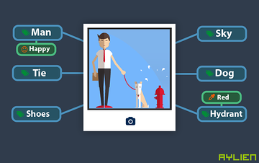
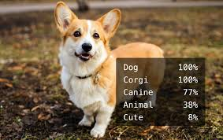
1. Data Labeling / annotation

Slide 84

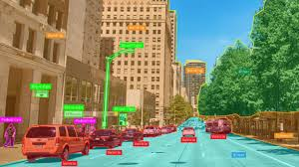

Slide 85
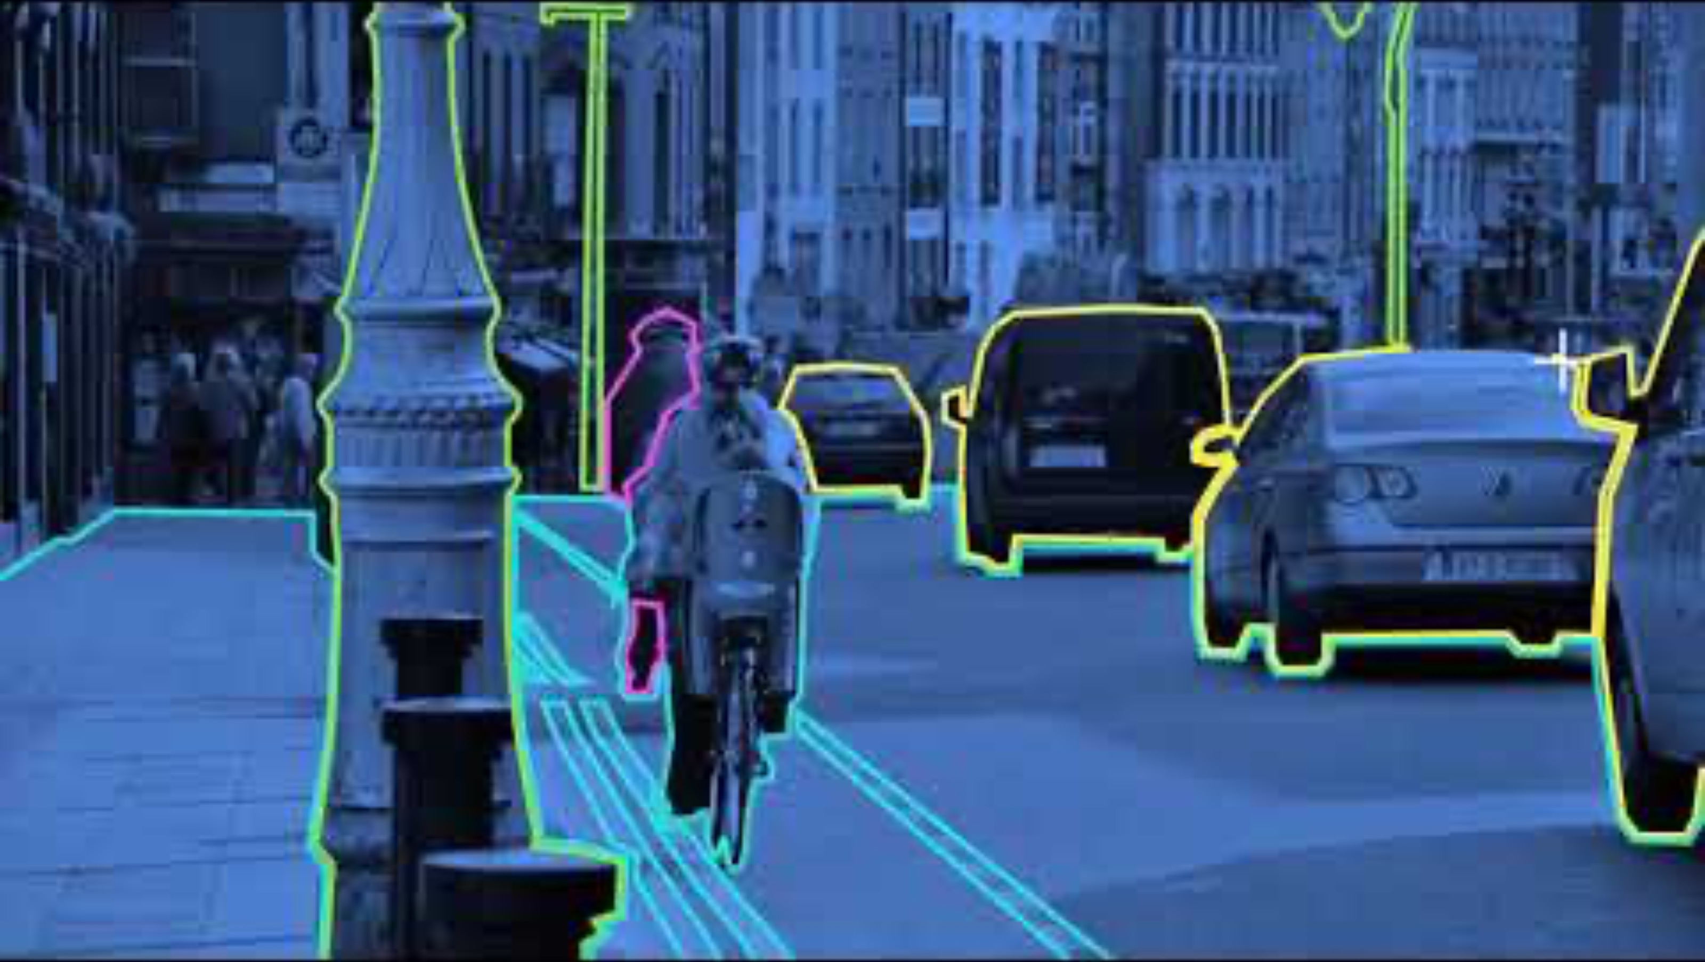

Slide 86
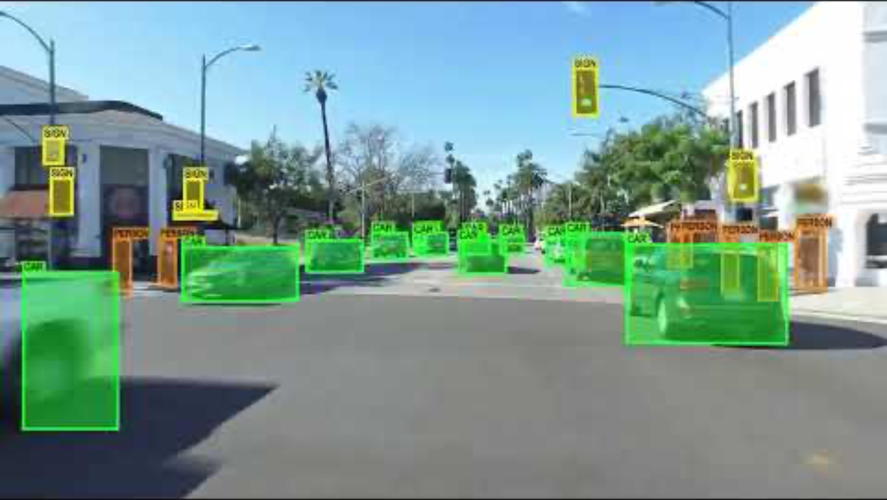

Slide 87


Slide 88
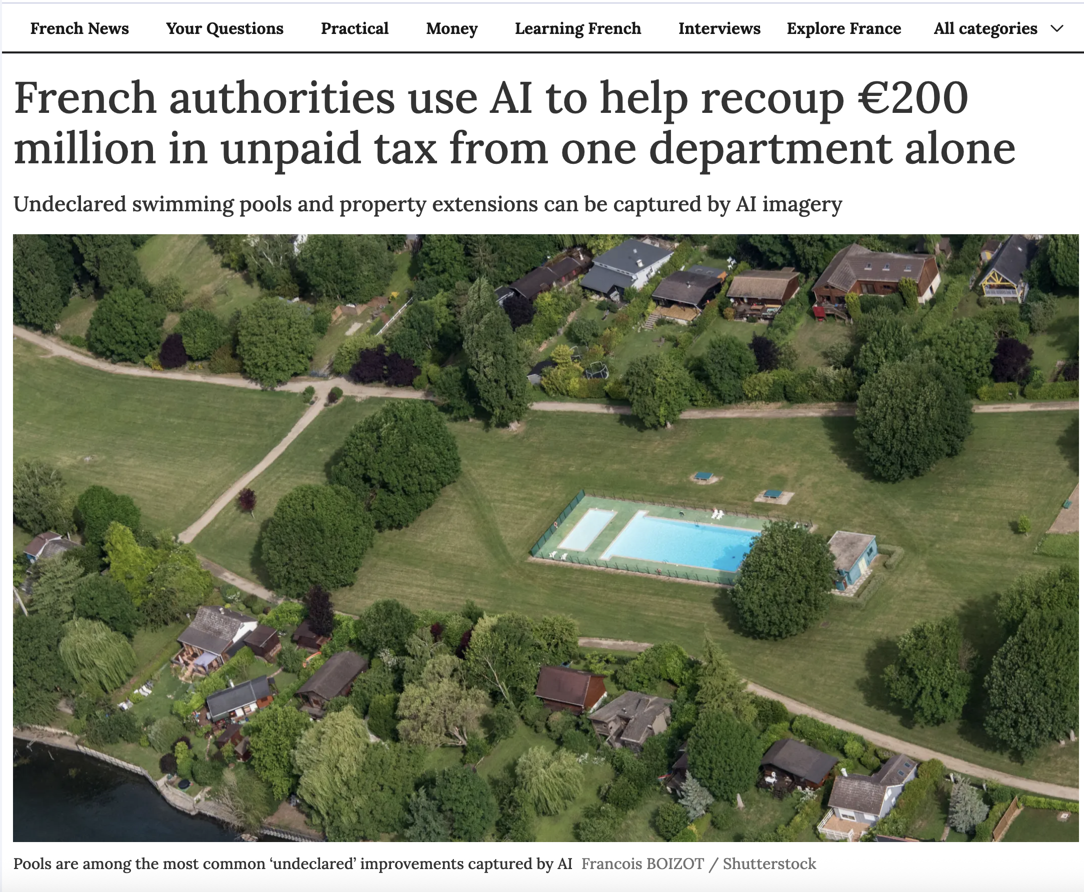
https://www.connexionfrance.com/practical/french-authorities-use-ai-to-help-recoup-200-million-in-unpaid-tax-from-one-department-alone/701469

Slide 89
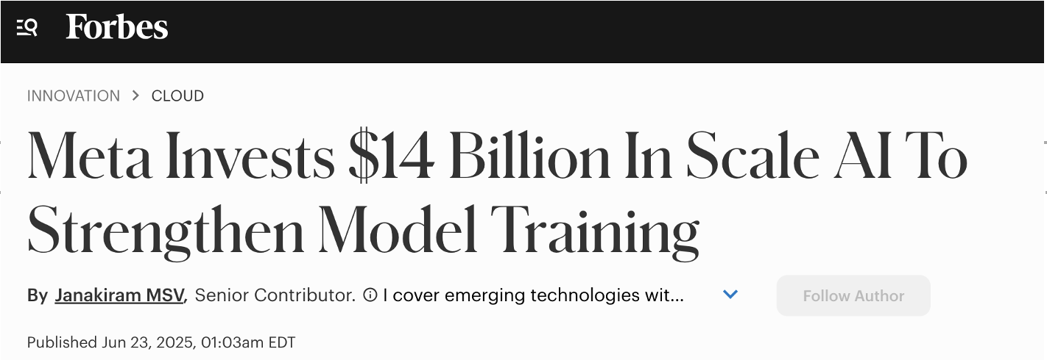
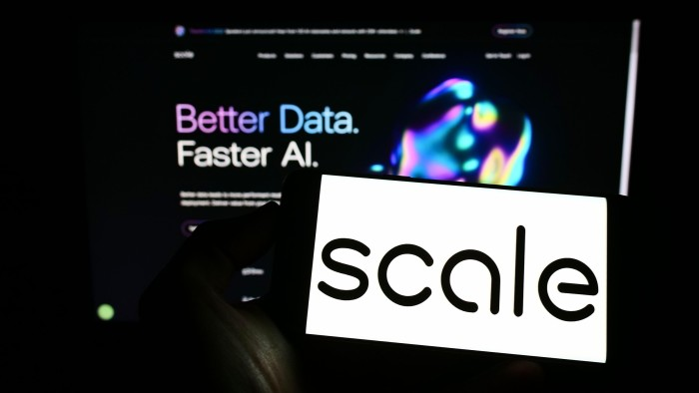

Slide 90
Data labelling: what nobody tells you
▪ Supervised learning needs labels, and labels usually come from humans
▪ It is slow and expensive — often the true cost of the whole project
▪ Labels are noisy. Two annotators disagree; measure it (inter-annotator agreement)
– If humans cannot agree on a label, no model can learn it reliably
▪ You need written guidelines with edge cases, or every annotator invents their own definition
▪ Use labels you already have — a resolved ticket's category, a click, an actual cancellation
▪ Label 200 examples carefully before labelling 5 000 quickly
Introduction to A.I · Umair M.I
81
Notes:
CONTEXT — The deep point is the accuracy ceiling: your model cannot be more consistent than your labels, so if two clinicians agree only 80% of the time, 80% is roughly your roof — and no model change raises it. Inter-annotator agreement (Cohen's kappa) is how you measure that, and it should be reported before anyone celebrates an accuracy number. 'Use labels you already have' is the practical shortcut students overlook: a support ticket's resolution category or an actual cancellation is a free label, produced by the business as a side effect of operating.

Slide 91


These two words are not synonyms
 | What it means | GDPR status
Pseudonymisation | Identifiers replaced by a key; re-identification still possible | Still personal data — GDPR applies
Anonymisation | Identification irreversibly prevented | No longer personal data — GDPR does not apply
Introduction to A.I · Umair M.I
82
Notes:
CONTEXT — The distinction is legal, not stylistic, and it decides whether you need a lawful basis, a retention limit and data-subject rights. Replacing a name with customer_8471 is pseudonymisation: the mapping exists somewhere, so GDPR still applies in full. True anonymisation is hard because of quasi-identifiers — techniques are generalisation (exact age → age band), suppression of rare rows, aggregation, k-anonymity (every combination of quasi-identifiers appears at least k times) and differential privacy for a quantified guarantee. Free text is the hardest part, because names and addresses hide inside sentences — which is what NAV's laundromat library exists to solve.

Slide 92
And the model itself can leak
▪ Large models can memorise and reproduce training examples verbatim
▪ “The data never left our servers, only the model did” is not automatically a privacy guarantee
▪ Norwegian checkpoints: Datatilsynet's guidance, your organisation's DPO, Sikt for research data
Introduction to A.I · Umair M.I · reference slide — also in the handout
83
Notes:
CONTEXT — Language models have been shown to emit memorised training data — names, addresses, phone numbers, code — when prompted adversarially. The consequence for architecture decisions is real: shipping a model trained on personal data can itself be a disclosure, so 'only the model left the building' is not a privacy argument on its own. For their own projects, the practical checkpoints are their organisation's data protection officer and, for research data, Sikt.

Slide 93
Synthetic data: genuinely useful, and genuinely limited
▪ Build and test a pipeline before you are granted access to sensitive data
▪ Teaching, demos, public code examples
▪ Augment a rare class so the model sees more of it
▪ Simulate what you cannot collect
– Amazon Go needed data of people taking items off shelves in a shop that did not exist yet — so they built a virtual shop and generated it
▪ But: it only contains patterns its generator knows. You inherit the biases and lose the rare edge cases — the ones that matter.
Synthetic data validates your code. It does not validate your conclusions.
Introduction to A.I · Umair M.I
84
Notes:
CONTEXT — The strongest practical use is the first one: access approval for sensitive data takes weeks or months, and synthetic data with the same schema lets you build and test the entire pipeline in the meantime — that is a real project-management win, not a compromise. The limitation is structural: if you fit a generator to real data you inherit its biases and smooth away the rare edge cases, which are exactly the cases that matter in fraud, safety and health. And synthetic data derived from personal data is not automatically outside GDPR — if individuals can be inferred, it is still personal data.

Slide 94
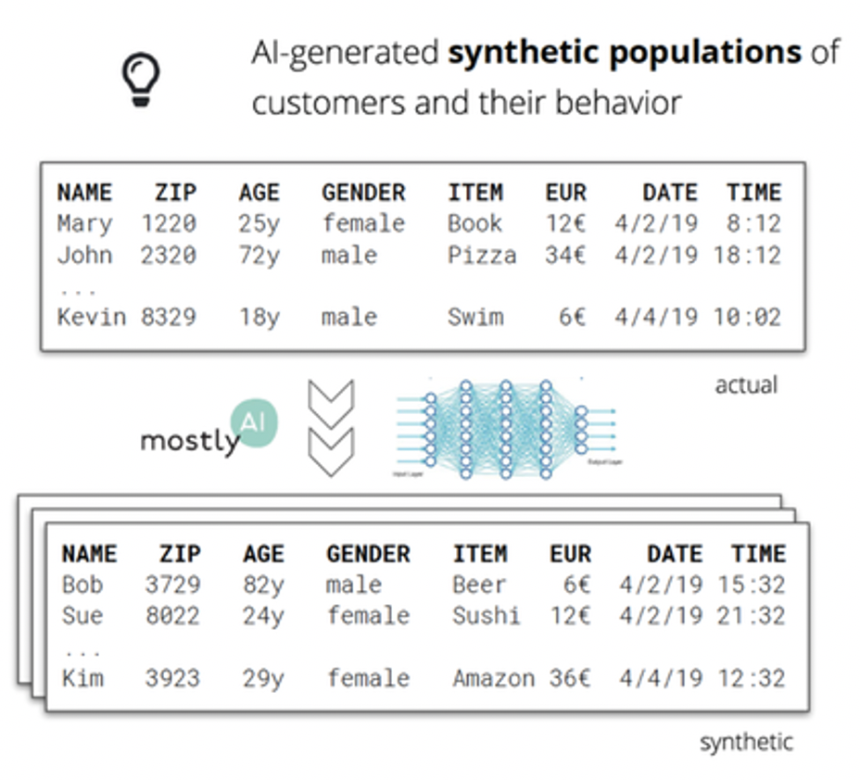

Slide 95
Try it yourself in the lab
from faker import Faker
fake = Faker("no_NO")
[{"name": fake.name(), "city": fake.city(), "born": fake.date_of_birth()}
for _ in range(5)]
# and NAV's laundromat, to mask Norwegian personal data inside free text:
# https://github.com/navikt/laundromat
Introduction to A.I · Umair M.I
86
Notes:
CONTEXT — Faker's `no_NO` locale produces plausible Norwegian names, addresses and postcodes. laundromat is NAV's open-source library for detecting and masking Norwegian personal information in free text — a good example of Norwegian public-sector code solving a real GDPR problem, and worth pointing at as a career signal: this is what public-sector AI work actually looks like.

Slide 96
The EU AI Act requires providers of high-risk systems to examine their training data for relevance, representativeness and bias — and to document it.
Documenting your dataset is no longer just good manners. Lecture 11.
Introduction to A.I · Umair M.I
90
Notes:
CONTEXT — Regulation (EU) 2024/1689, Article 10, sets data-governance requirements for high-risk AI systems: training, validation and test data must be examined for relevance, representativeness, errors and bias, with documentation to match. Norway implements this through the EEA agreement, and Norwegian public-sector procurement is already asking suppliers for exactly this material. The academic idea behind it is 'datasheets for datasets' (Gebru et al., 2018), which is on the further reading list.

Slide 97
Five things to take away
▪ Data is 80% of the job, and the fastest route to a better model
▪ Look before you clean — profile, then decide, then write down why
▪ The dangerous errors are silent — decimal commas, "None", dropped rows, lost leading zeros
▪ Leakage is the number one way to fool yourself
▪ Clean → engineer → split → then fit your transformations
Introduction to A.I · Umair M.I
92
Notes:
CONTEXT — Each line ties back to a moment they experienced rather than a definition they heard: the poll, the profiling demo, the Norwegian CSV, the 99% model, and the closing challenge. That mapping is deliberate — recall is much better for content attached to an event, which is the whole design principle behind this version of the lecture.

Slide 98
Next week: Machine Learning I — we finally train something.
It will only work because of what you did today.
Introduction to A.I · Umair M.I
95
Notes:
CONTEXT — Week 37 is linear regression with scikit-learn, plus visualising predictions and interpreting regression error. It reuses today's X_train directly — which is the cleanest possible argument that this lecture was not a detour.

Slide 99
Questions?
Introduction to A.I · Umair M.I
96

